Slide 1
Smart Cities in Albuquerque (aka Somewhere Bold)
Brian Osterloh
City of Albuquerque Director of Dept of Technology & Innovation
UNM BA (1989, Geography w/ Math Minor) & UNM MWRA (1992, Water Res Admin)

Slide 2
What is a Smart City?
Wikipedia: A Smart city is an urban area that uses different types of electronic Internet of Things (IoT) sensors to collect data and then use insights gained from that data to manage assets, resources and services efficiently. This includes data collected from citizens, devices, and assets that is processed and analyzed to monitor and manage traffic and transportation systems, power plants, utilities, water supply networks, waste management, crime detection,^{[1]} information systems, schools, libraries, hospitals, and other community services.
TechRepublic: The IDC defines smart city development as the use of smart initiatives combined to leverage technology investments across an entire city, with common platforms increasing efficiency, data being shared across systems, and IT investments tied to smart missions.
IoT Agenda: A smart city is a municipality that uses information and communication technologies (ICT) to increase operational efficiency, share information with the public and improve both the quality of government services and citizen welfare.

Slide 3
What is a Smart City?
Albuquerque: A Smart city is an urban area that uses insights gained from various data collection mechanisms to improve community conditions by aligning and optimizing services toward those conditions to be improved.
A condition may be a problem area
Education level attainment
Public safety
Senior engagement
A condition may be a basic service
Street lighting
Trash pickup
Transportation

Slide 4
What is a Smart City?
Albuquerque
A condition may be a new opportunity
Film industry employment
Smart device development and manufacturing
Connected or Autonomous vehicle testing
A Smart City often gets out of the way because it isn’t exclusively smart
A Smart City always considers new ideas
A Smart City sometimes fails (but it fails early because it is smart)

Slide 5
Private Sector Disruption
Uber, the world’s largest taxi company, owns no vehicles.
Facebook, the world’s most popular media owner, creates no content.
Alibaba, the most valuable retailer, has no inventory.
Airbnb, the world’s largest accommodation provider, owns no real estate, $10B valuation.
These companies disrupt their industry by reducing friction for service requesters and service providers.

Slide 6
Public Sector Opportunities
Cities are complex organizations. CABQ runs dozens of unique businesses/services.
Trash & recycle collection
Security
Law Enforcement
Fire and Rescue
Libraries
Zoo
Museums
Performance spaces
Early childhood development
Out of school care
Recreation programs
Golf courses

Slide 7
Public Sector Opportunities
Cities are complex organizations. CABQ runs dozens of unique businesses/services. (still more)
Airport
Buses
Street construction and repair
Traffic management
Community engagement
Economic development
Street construction and repair
Meal delivery
Regulatory compliance
Internal services such as finance, budget, HR, performance management, information technology

Slide 8
Where to start?
Quite simply, somewhere
Albuquerque has a history of innovation
Clean room was invented in Albuquerque (Sandia)
Microsoft was here
City is (commercial?) license number 6 with ESRI (GIS behemoth)
The CABQ website is one of the first 10,000 in the history of the world (according to websitehostingrating.com, there were 1,744,517,326 as of Jan 1, 2020)
CABQ 311 was one of the first in the country
CABQ is the first city in the country to enable service request submission via Alexa

Slide 9
Where did we start?
Quite simply, somewhere
In 2005, 311 was a Smart City innovation
In 2007, use of 311 data was a Smart City innovation
In 2012, Open Data was a Smart City innovation
In 2013, TXT2RIDE was a Smart City innovation
In 2017, Smart LED lighting was a Smart City innovation
In 2017, Alexa was a Smart City innovation
In 2017, Traffic Signal Prioritization was a Smart City innovation
In 2020, the above are not good enough and talking and hype have become the norm

Slide 10
Where to now?
Set Theory
Stanford Encyclopedia of Philosophy: Set theory is the mathematical theory of well-determined collections, called sets, of objects that are called members, or elements, of the set.
Albuquerque Smart City usage: The collection of members (or components) in varying quantities and combinations to improve relatable community conditions.
Members include:
Data elements
Data collection tools and mechanisms
Policies, regulations and statutes

Slide 11
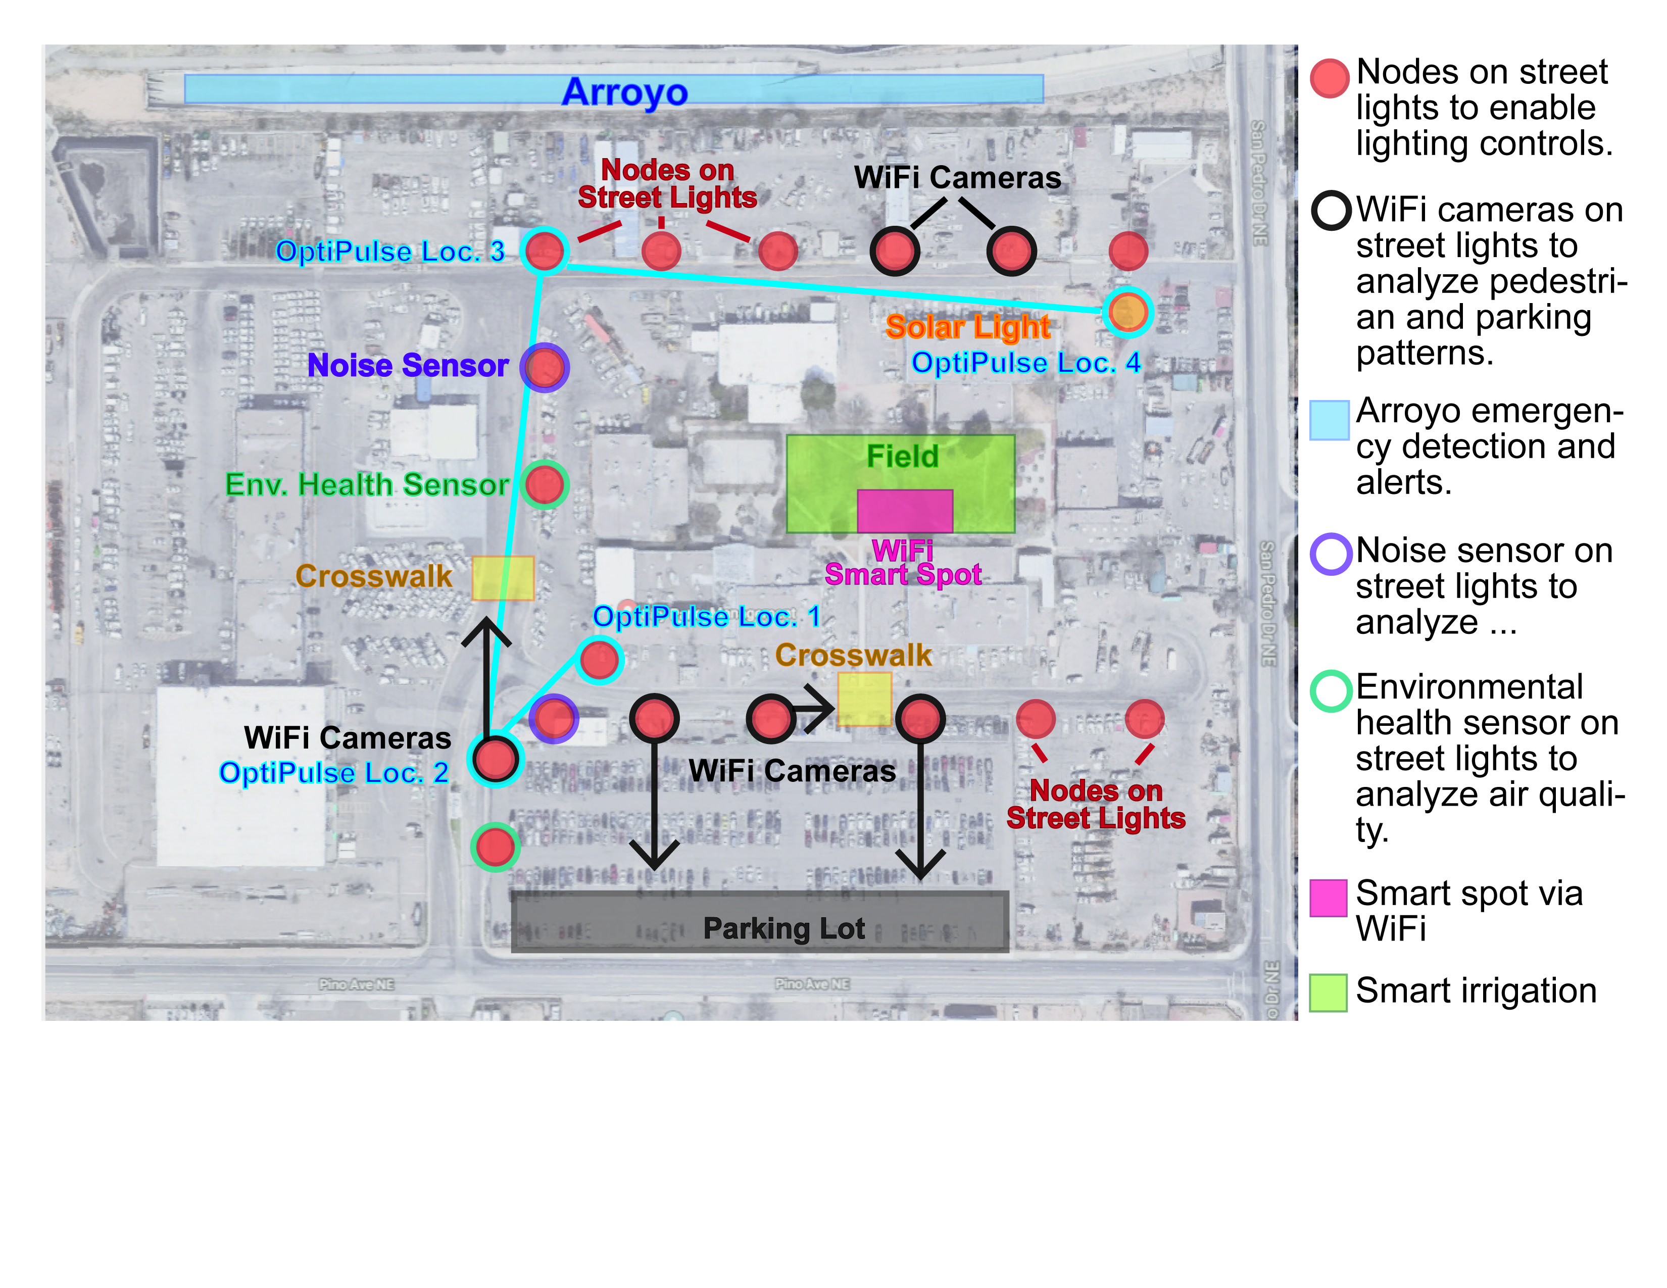
What might this look like?

Slide 12
How does one make this work?
Best Practices
Know them. Don’t necessarily follow them.
If you are leading the way, you can’t be following.
‘Best’ practices are usually most commonly followed practices.
Be prepared for errors and even failures
Don’t be stupid. You are spending somebody else’s money and resources.
Don’t be afraid. You are trying to improve your and somebody else’s conditions.
Don’t do this all by yourself
There is strength in numbers.
Challenge the assumptions. Especially, challenge the assumption you are right and the other person is wrong.
Cache ideas. They will almost certainly prove useful at some point.

Slide 13
This is completely new; in all the same old ways.
If it’s cool and exciting, it will be expected yesterday.
If it’s new and untested, you need to test it.
If it’s reliable and tested, you need to test it.
Really, it looks a lot like writing other software.
If it can happen, it will.
You don’t have to design it in, but don’t design it out.
Security matters.
Your users matter most.

Slide 14
Questions? Queries? Conundrums? Comments…
You ask me.
I ask you.
We’re not leaving until the end.

